Slide 1
Duchenne Day 18/04/2015
Project 1.3-Intention Amplifying in Hand Orthoses
Kostas Nizamis
Claudia Haarman
Ronald Bos

Slide 2
Project Description
Project 1.3- Intention Amplifying in Hand Orthoses Develop an intuitive hand orthosis for active hand support for people with Duchenne Muscular Dystrophy (DMD).

Slide 3
Project Description
Kostas
Intuitive control strategies for a high-tech, multi-DOF hand orthosis (4 years)
Claudia
Development of functional hand orthosis for use throughout the disease (2 years)
Ronald
Development of mechanisms that allow for transparent (predictable) man-machine interaction, a comfortable fit and inconspicuous design (4 years)
→ Integration of hand orthosis into the Flextension arm device

Slide 4
Researcher interaction
Symbionics 1.3
Ronald (PhD)
Device implementations & components
Integration of device components
Exchange of information, sources
Claudia (PDEng)
Hand orthosis for DMD patients
Integration of control interface with orthosis
Kostas (PhD)
Intention detection for DMD patients

Slide 5
Ronald Delft University of Technology r.a.bos@tudelft.nl
Develop mechanisms that allow for transparent (predictable) man-machine interaction, a comfortable fit and inconspicuous design.
Hand orthosis
Energy storage
Actuators
Force transmission
Mechanism design
Control method
Synergies
Cosmesis
Comfort
Control
Aesthetics
Obtrusiveness
Joint alignment
Interaction forces
Intuitiveness
Versatility
Robustness
Plettenburg (2006)

Slide 6
Kostas University of Twente k.nizamis@utwente.nl
2012-2014 Biomedical Engineering MSc. University of Twente, The Netherlands
Master Thesis: Development of an EMG-based control interface for active arm support for people with Duchenne Muscular Dystrophy
HUMAN
PERSON WITH
DMD
CONTROL INTERFACE
ORTHOSIS
KOSTAS
HAND ORTHOSIS

Slide 7
Kostas University of Twente k.nizamis@utwente.nl
ICORR15_0123_VI_i.mpg

Slide 8
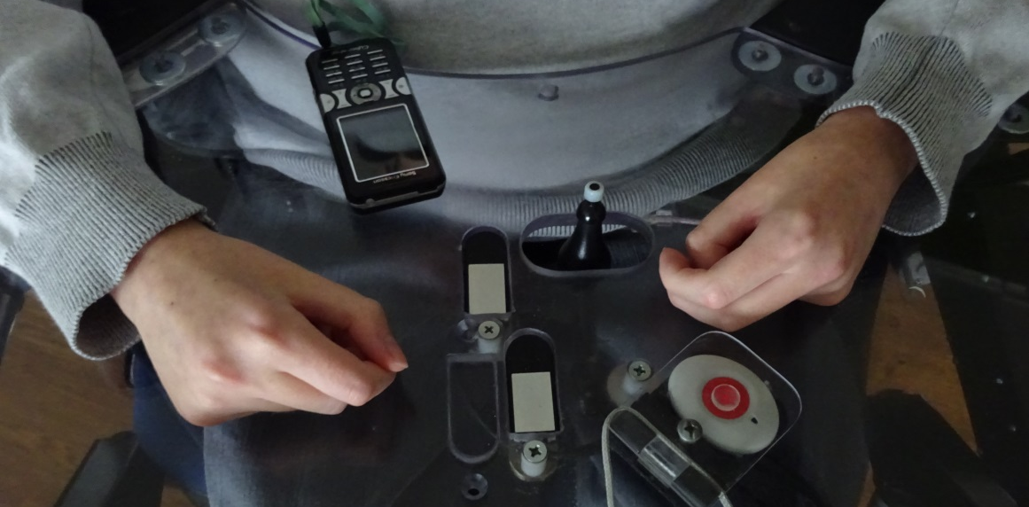
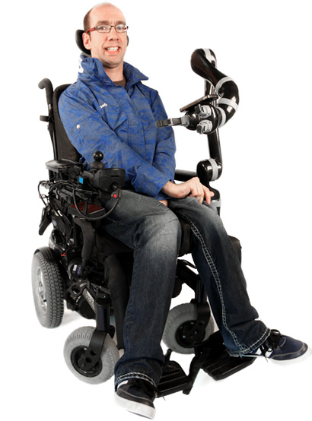
Claudia Haarman University of Twente c.j.w.haarman@utwente.nl
Goal:
Develop functional hand orthosis
in 2 years
Current solution
Physiotherapy to slow down progression of disease
Robotic grippers
But, hand function is not restored!
that can also serve as research platform for Kostas

Slide 9
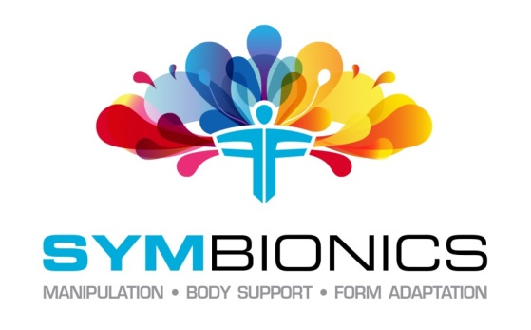
Intention Amplifying in Hand Orthoses

