Slide 1
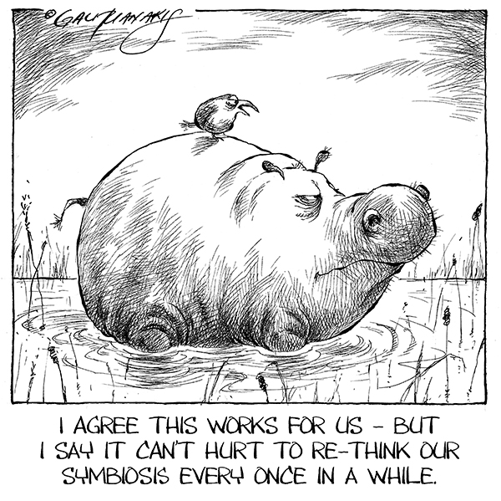
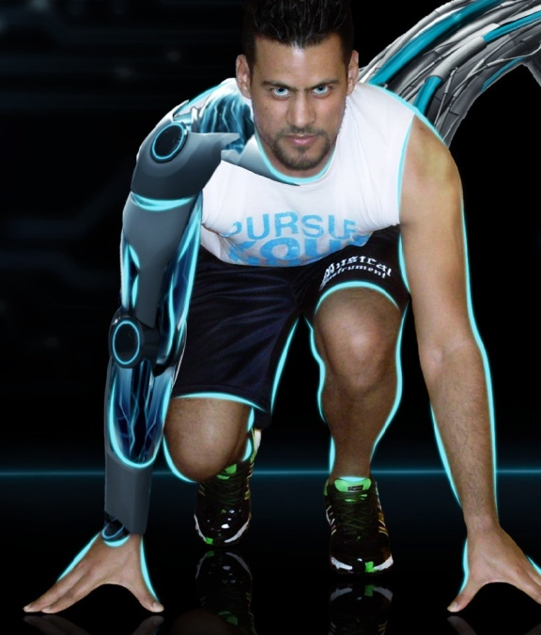
Notes:
Goodafternoon! We want to tell you something about the symbionics projects which is started in the end of last year.
The name is composed of two terms: symbiosis and bionics. Symbiosis is the way of two species living (/working) together and bionics means using nature mechanisms in engineering.
So the goal of the Symbionics program is to develop assistive devices that adapt to the user and adapt to the environment, depending on the task. So the devices should adapt to the user and not the other way around.
Today we will give an insight in two of the projects within the symbionics program.

Slide 2
Co-adaptive support of trunk and head in relation to arm movements
Laura Peeters
Mohammad Nauzef Mahmood
Stergios Verros
Notes:
I’m going to tell you something about the project about the development of a co-adaptive support of the trunk and head. My name is Laura and I work within this project as researcher together with Nauzef and Stergios. I will explain the word co-adaptive later on.

Slide 3
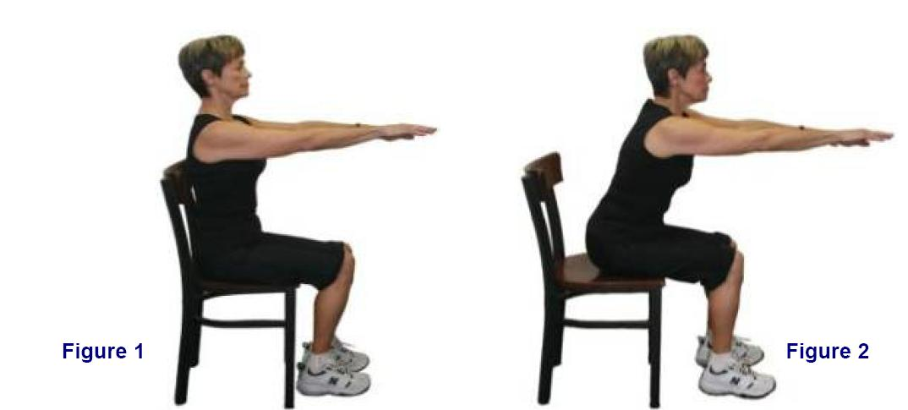
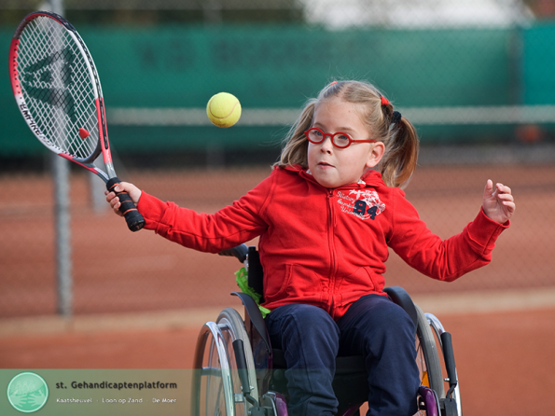
Problem outline
Coordination arm, trunk and head movement important in activities of daily living
Movement is influenced by:
Weakening of the muscles
Development of deformations (like scoliosis)
Compensatory strategies
Compensation
Scoliosis
Notes:
It is important for daily activities to be able to position the hand in a large area around the body, especially when you are confined to the wheelchair. This is only possible when you move your trunk as well, as you can see in the picture with reaching. The position of the head can also not been seen seperately, whereby the head also provides important visual and balance input. Like you can see in the picture of the girl playing tennis, it is important that she can see were the ball is and that she can coordinate her arm to hit the ball. So the interaction between the arm, trunk and head are very important in activities of daily living.
People with flaccid or spastic paresis, including Duchenne, have weak muscles and performing daily activities becomes more difficult. Development of deformations (like scoliosis or contractures) have also an nagative influence on the movement and therefore performing daily activities. Last, compensatory strategies are seen quite often to compensate for the loss of muscle strength (like you can see in the movie). The movement pattern and the coordination of the trunk, head and arm are disrupted.
So looking at the arm, is not good enough.

Slide 4
General description of the project
Problem formulation:
People with flaccid or spastic paresis are unable to move due to muscular weakness
Solution:
Develop an assistive device that will enable the user to perform daily tasks
Notes:
So, the problem is that people with flaccid or spastic paresis are unable to move due to muscular weakness. This makes them unable to perform daily tasks and additional assistance is needed (from a person or a device). Thus the aim of the project is to develop two assistive devices, one for the trunk and one for the head, that enable the user to perform daily tasks. These assistive devices could be used together and with the arm supportive device, like Micha told you, when desirable. So the people are able to perform daily activities independent.

Slide 5
Project Structure
Movement analysis (Laura)
Mechanical Design (Nauzef)
Electrical Design (Stergios)
Notes:
As I told before, the three of us are working closely together to develop the supportive devices for the trunk and head, but each one of us as a specific focus. I’m going to look at the movement of the trunk and head while performing arm tasks. I shall compare healthy children with children with DMD, SMA and CP to see where the device should provide support and how much support is needed. But also how this changes during the progression of the disease.
Nauzef is going to work on the mechanical design. So he is going to be focussing on how should the devices look like. Which materials do we need? How much joints are needed in the device? Which shapes/structures are comfortable for the user?
Stergios is going to work on the electrical design. This means that he is going to be focussing on how the devices can be controlled. If you are too weak to move by yourself, you have to let the device know where you want to move. Therefore you need to measure where you want to go, afterwards the device assist you to move in the right direction.

Slide 6
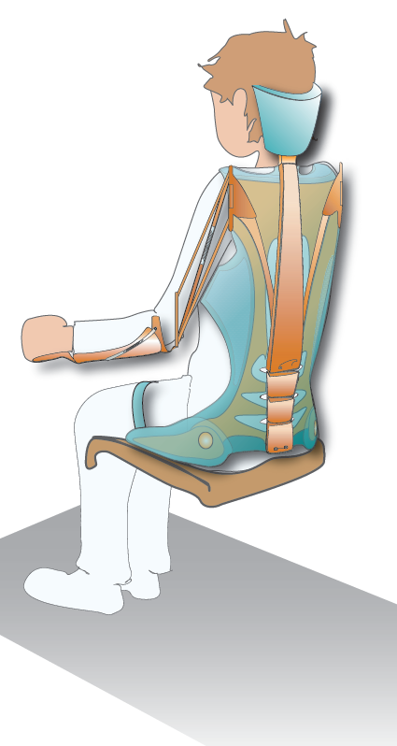
Future Concept
Features:
Optimal functional support for trunk and head
Adaptibility along with fatigue, age and disease progression
Comfortness, possibility of wearing under clothes
Notes:
Last, some features we think/hope to include in the device. First of all, it should give optimal functional support for the trunk and head in daily activities. Optimum support provided by the device would use the users capacity fully, thereby encouraging the user to do more activities on his own, which slows down the muscle degeneration.
The amount of support should be adaptable along with fatigue (so different support during the day), age and disease progression. With progression of the disease you need more support.
We also want to keep focus on you, the users, so comfortness is very important. We also would like to make a device which can be worn under the clothes, so it is less visible.
In the end we hope to have a supportive device for the trunk and the head, which also can be integrated with an arm support, which gives support to perform daily activities independently.

Slide 7
Thank you and …
Notes:
We would like to thank you for your attention and.. We will need your help in the future! We want to make a device for you, so your opinion is very important. We need volunteers for the movement analysis, for testing prototypes and measurement methods. And if you have any good idea’s, suggestions, things we should not forget, please let us know!

Slide 8
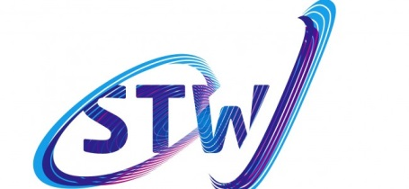
Co-adaptive support of trunk and head in relation to arm movements

